Slide 1

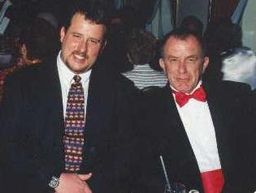
Exposure Java 2013
APCS Edition
Chapter 13 Slides
Boolean Logic & Control Structures
PowerPoint Presentation
created by:
Mr. John L. M. Schram
and Mr. Leon Schram
Authors of Exposure Java

Slide 2
Section 13.1
Introduction

Slide 3
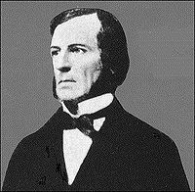
George Boole
More than 150 years ago,
there was a mathematician
named George Boole, who took
statements and wrote them in
a precise format, such that a
statement is always true or false.
He founded a branch of mathematics
called Boolean Algebra.
Statements that are either true or false are called Boolean statements. The conditions you used with selection and repetition back in Chapter 5 were all Boolean statements.
There is a boolean datatype named after George Boole.

Slide 4
AP Exam Alert
The APCS Examination includes a variety of Boolean Logic questions.
Many questions require indirect knowledge of Boolean Logic, and other questions are directly focused on testing a student’s understanding of Boolean concepts.
Test results have shown that many students score quite poorly on this part of the APCS Examination.
Statistical Analysis of these test results have also shown that the students who perform poorly on Boolean Logic questions, perform poorly on the AP Exam as a whole; and the students who perform well on the Boolean Logic questions, perform well on the AP Exam as a whole.

Slide 5
Section 13.2
What is a
Boolean
Statement?

Slide 6
What is a Boolean Statement?
The sentence, statement, condition, whatever, must be true or false.
No questions, no ambiguities, no arguments.
The basis of processing data is the binary system of on and off, or 1 and 0, which certainly sounds a bunch like true or false.
Each of the following five statements is a Boolean statement:
A mile is longer than a kilometer.
July and August both have the same number of days.
A pound of feathers is lighter than a pound of lead.
The Moon is larger than the Sun.
New York City has more people than Baltimore.

Slide 7
Boolean Statement Examples
English Sentence | Boolean Statement | T/F
A mile is longer than a kilometer. | Mile > Kilometer | True
July and August have the same days. | JulDays == AugDays | True
A pound of feathers is lighter than a pound of lead. | PoundF < PoundL | False
The Moon is larger than the Sun. | MoonSize > SunSize | False
New York City has more people than Baltimore. | NYPop > BaltPop | True

Slide 8
Sentences are not always so short and straight forward. Frequently there are multiple conditions in one statement. Special rules need to be followed to determine if the entire statement is true or false.
Consider the following sentences with compound conditions:
She is a computer science teacher and she is a math teacher.
The number is odd or the number is even.
Enter again if gender is not male or gender is not female.
Employment requires a CPA and five years experience.
The same sentences converted into Boolean statements are:
(She == CSTeacher) and (She == MathTeacher)
(Number % 2 == 1) or (Number % 2 == 0)
(Gender != ‘M’) or (Gender != ‘F’)
(CPA == ‘Y’) and (YrExp >= 5)

Slide 9
Section 10.3
Boolean
Operators

Slide 10
Logical OR Example
Consider two young ladies who have a rather simplistic, and quite politically incorrect, view of judging potential dates. The first is Kathy who will date a guy if he is Good Looking OR drives a Nice Car. This chart shows her 4 possible cases:
Good Looking? | Nice Car? | Date Material?

Slide 11
Boolean Operators Boolean OR
A
T
T
F
F
B
T
F
T
F
A or B
T
T
T
F

Slide 12
Logical AND Example
Suzy is more picky than Kathy. Suzy will only date a guy if he BOTH Good Looking AND drives a Nice Car. This chart shows her 4 possible cases:
Good Looking? | Nice Car? | Date Material?

Slide 13
Boolean Operators Boolean AND
A
T
T
F
F
B
T
F
T
F
A and B
T
F
F
F

Slide 14
Boolean Operators Boolean XOR
A
T
T
F
F
B
T
F
T
F
A xor B
F
T
T
F

Slide 15
Boolean Operators Boolean NOT
A
T
F
~A
F
T

Slide 16
Boolean Operators Boolean NOT Continued
A
T
T
F
F
B
T
F
T
F
~A
F
F
T
T
~B
F
T
F
T

Slide 17
Section 13.4
Truth
Tables

Slide 18
Truth Table #1 (A and B) or B
A
T
T
F
F
B
T
F
T
F
A or B
T
T
T
F
A and (A or B)
T
F
T
F

Slide 19
Truth Table #2 (A and B) or C
A
T
T
T
T
F
F
F
F
B
T
T
F
F
T
T
F
F
C
T
F
T
F
T
F
T
F
A and B
T
T
F
F
F
F
F
F
(A and B) or C
T
T
T
F
T
F
T
F

Slide 20
Truth Table #3 (A or B) and C
A
T
T
T
T
F
F
F
F
B
T
T
F
F
T
T
F
F
C
T
F
T
F
T
F
T
F
A or B
T
T
T
T
T
T
F
F
(A or B) and C
T
F
T
F
T
F
F
F

Slide 21
Truth Table Fact
The truth tables of equivalent Boolean expressions are identical.

Slide 22
Truth Table #4 Is ~(A or B) = ~A or ~B ?
A
T
T
F
F
B
T
F
T
F
A or B
T
T
T
F
~(A or B)
F
F
F
T
~A
F
F
T
T
~B
F
T
F
T
~A or ~B
F
T
T
T
^ NO ^

Slide 23
Truth Table #5 Is ~(A or B) = ~A and ~B ?
A
T
T
F
F
B
T
F
T
F
A or B
T
T
T
F
~(A or B)
F
F
F
T
~A
F
F
T
T
~B
F
T
F
T
~A and ~B
F
F
F
T
^ YES ^

Slide 24
Truth Table #6 Is ~(A and B) = ~A or~B ?
A
T
T
F
F
B
T
F
T
F
A and B
T
F
F
F
~(A and B)
F
T
T
T
~A
F
F
T
T
~B
F
T
F
T
~A or ~B
F
T
T
T
^ YES ^

Slide 25
DeMorgan’s Law
not(A and B) = not A or not B
not(A or B) = not A and not B

Slide 26
Section 13.5
The boolean
Datatype

Slide 27
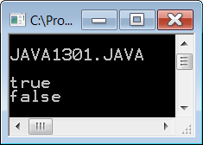
// Java1301.java
// This program demonstrates that conditional statements have
// true or false Boolean values and can display such values.
public class Java1301
{
public static void main(String args[])
{
System.out.println("\nJAVA1301.JAVA\n");
int x =10;
System.out.println(x == 10);
System.out.println(x == 5);
System.out.println();
}
}

Slide 28
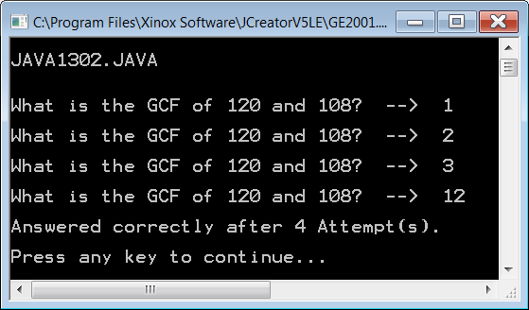
Output for the next
2 programs…

Slide 29
// Java1302.java
// This program demonstrates that boolean variables add readability to programs.
public class Java1302
{
public static void main (String args[])
{
System.out.println("\nJAVA1302.JAVA\n");
Scanner input = new Scanner(System.in);
int gcf;
boolean correct = false;
int attempt = 0;
while (!correct)
{
attempt++;
System.out.print("\nWhat is the GCF of 120 and 108? --> ");
gcf = input.nextInt();
if (gcf == 12)
correct = true;
else
correct = false;
}
System.out.println("\nAnswered correctly after " + attempt + " Attempt(s).\n");
}
}

Slide 30
// Java1303.java
// This program executes in the same manner as Java1302.java.
// The abbreviated Boolean assignment statement is used in place of the longer <if...else> syntax.
import java.util.Scanner;
public class Java1303
{
public static void main (String args[])
{
System.out.println("\nJAVA1303.JAVA\n");
Scanner input = new Scanner(System.in);
int gcf;
boolean correct = false;
int attempt = 0;
while (!correct)
{
attempt++;
System.out.print("\nWhat is the GCF of 120 and 108? --> ");
gcf = input.nextInt();
correct = (gcf == 12);
}
System.out.println("\nAnswered correctly after " + attempt + " Attempt(s).\n");
}
}

Slide 31
Think of it this way…
Variable | Expression | Assignment
int x; | 23 + 45 | x = 23 + 45;
double y; | 66.23 - 8.11 | y = 66.23 - 8.11;
String name; | “John” + “Smith” | name = “John”+”Smith”;
boolean pass; | grade >= 70 | pass = grade >= 70;
A boolean expression
can be assigned to a boolean variable
just like int/double/String expressions
can be assigned to int/double/String variables.

Slide 32
Section 13.6
Nested
Selection

Slide 33
// Java1304.java
// This program displays an admission message based on an entered SAT score.
// It also determines financial need with a nested <if...else> control structure.
public class Java1304
{
public static void main (String args[])
{
System.out.println("Java1304\n");
Scanner input = new Scanner(System.in);
int sat;
double income;
System.out.print("Enter your SAT score ===>> ");
sat = input.nextInt();
if (sat >= 1100)
{
System.out.println("You are admitted");
System.out.print("Enter your family income ===>> ");
income = input.nextDouble();
if (income <= 20000)
System.out.println("You will receive financial aid");
else
System.out.println("You will not receive financial aid");
}
else
{
System.out.println("You are not admitted");
}
}
}

Slide 34
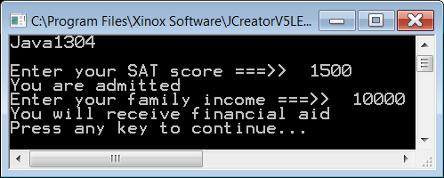
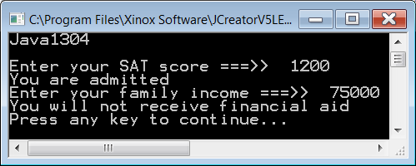
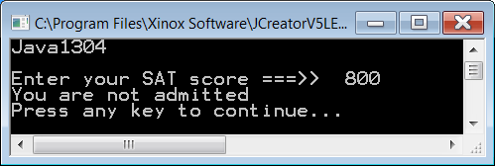

Slide 35
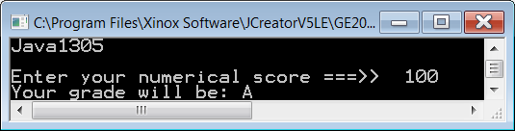
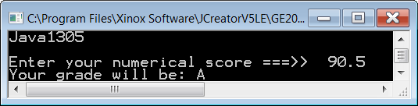
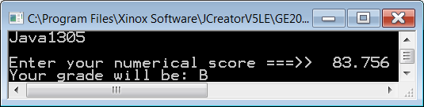
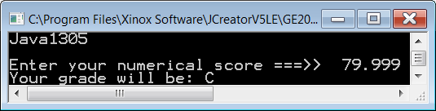
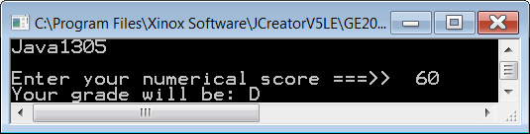

// Java1305.java
// This program assigns grades 'A'..'F' based on numerical scores
// using multiple nested if..else statements.
public class Java1305
{
public static void main (String args[])
{
System.out.println("Java1305\n");
Scanner input = new Scanner(System.in);
double score;
char grade;
System.out.print("Enter your numerical score ===>> ");
score = input.nextDouble();
if (score >= 90.0)
grade = 'A';
else if (score >= 80.0)
grade = 'B';
else if (score >= 70.0)
grade = 'C';
else if (score >= 60.0)
grade = 'D';
else
grade = 'F';
System.out.println("Your grade will be: " + grade);
}
}
Is this really multi-way selection?

Slide 36
Section 13.7
Nested
Looping

Slide 37
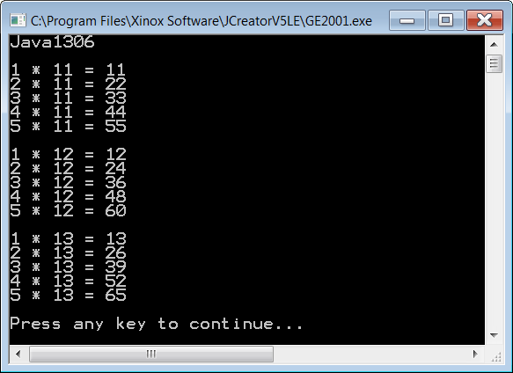
Output for the
next 2 programs:

Slide 38
// Java1306.java
// This program displays several multiplication tables using
// a nested <for> loop structure.
public class Java1306
{
public static void main(String args[])
{
System.out.println("Java1306\n");
for (int table = 11; table <= 13; table++)
{
for (int k = 1; k <= 5; k++)
{
System.out.println(k + " * " + table + " = " + k * table);
}
System.out.println();
}
}
}

Slide 39
// Java1307.java
// This program displays several multiplication tables using
// nested pre-condition <while> loop structures.
public class Java1307
{
public static void main(String args[])
{
System.out.println("Java1307\n");
int k = 1;
int table = 11;
while (table <= 13)
{
while (k <= 5)
{
System.out.println(k + " * " + table + " = " + k * table);
k++;
}
System.out.println();
k = 1;
table++;
}
}
}

Slide 40
Section 13.8
Compound
Conditions

Slide 41
// Java1308.java
// This program demonstrates compound decisions with the logical or ( || ) operator.
public class Java1308
{
public static void main (String args[])
{
System.out.println("Java1308\n");
Scanner input = new Scanner(System.in);
int education; // years of education
int experience; // years of work experience
System.out.print("Enter years of education ===>> ");
education = input.nextInt();
System.out.print("Enter years of experience ===>> ");
experience = input.nextInt();
if ( education >= 16 || experience >= 5 )
System.out.println("You are hired");
else
System.out.println("You are not qualified");
}
}

Slide 42
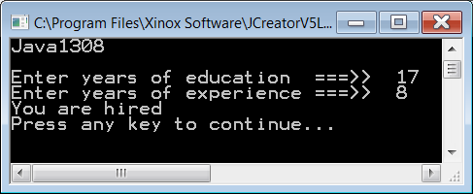


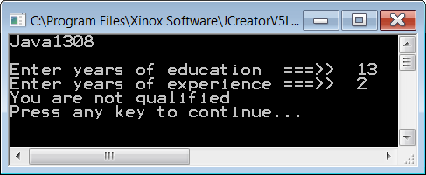
4 Outputs with OR

Slide 43
// Java1309.java
// This program demonstrates compound decisions with the logical and ( && ) operator.
public class Java1309
{
public static void main (String args[])
{
System.out.println("Java1309\n");
Scanner input = new Scanner(System.in);
int education; // years of education
int experience; // years of work experience
System.out.print("Enter years of education ===>> ");
education = input.nextInt();
System.out.print("Enter years of experience ===>> ");
experience = input.nextInt();
if ( education >= 16 && experience >= 5 )
System.out.println("You are hired");
else
System.out.println("You are not qualified");
}
}

Slide 44

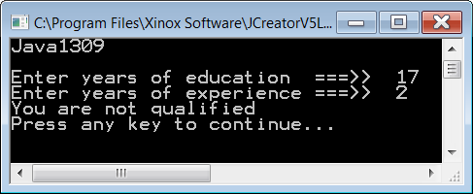


4 Outputs with AND

Slide 45
Java Logical Operators
Java uses || to indicate a logical OR.
Java uses && to indicate a logical AND.
Java uses ! to indicate a logical NOT.
Java uses != for not equals, but != can
also be used to indicate a logical XOR.

Slide 46
Section 13.9
Program Input
Protection

Slide 47
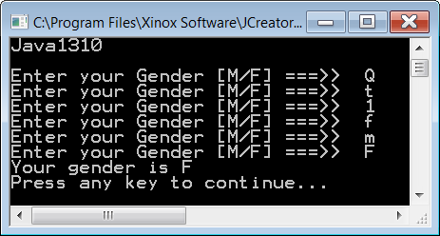
// Java1310.java
// This program demonstrates compound decision with a do...while loop.
// The program checks for proper data entry.
// The addition of charAt(0) allows the nextLine method to enter a single character.
public class Java1310
{
public static void main (String args[])
{
System.out.println("Java1310\n");
Scanner input = new Scanner(System.in);
char gender;
do
{
System.out.print("Enter your Gender [M/F] ===>> ");
gender = input.nextLine().charAt(0);
}
while (!(gender == 'M' || gender == 'F') );
System.out.println("Your gender is " + gender);
}
}

Slide 48
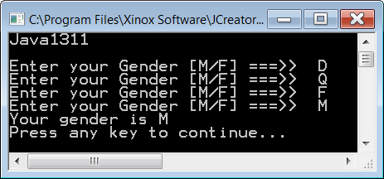
// Java1311.java
// This program demonstrates compound decision with a do...while loop.
// The program does not work properly because of misplaced parentheses.
public class Java1311
{
public static void main (String args[])
{
System.out.println("Java1311\n");
Scanner input = new Scanner(System.in);
char gender;
do
{
System.out.print("Enter your Gender [M/F] ===>> ");
gender = input.nextLine().charAt(0);
}
while ( !(gender == 'M') || gender == 'F' );
System.out.println("Your gender is " + gender);
}
}

Slide 49

Watch Your Parentheses!
Correct
while ( !( gender == 'M' || gender == 'F' ) );
Incorrect
while ( !( gender == 'M' ) || gender == 'F' );

Slide 50
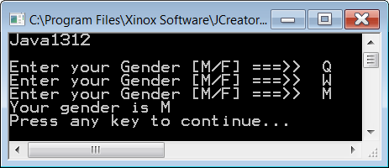
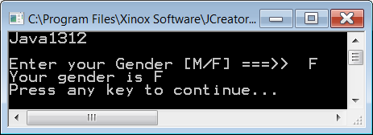
// Java1312.java
// This program demonstrates correct use of negative compound
// decision structure using DeMorgan's Law.
public class Java1312
{
public static void main (String args[])
{
System.out.println("Java1312\n");
Scanner input = new Scanner(System.in);
char gender;
do
{
System.out.print("Enter your Gender [M/F] ===>> ");
gender = input.nextLine().charAt(0);
}
while (gender != 'M' && gender != 'F');
System.out.println("Your gender is " + gender);
}
}

Slide 51
DeMorgan’s Law Again
not(A and B) = not A or not B
not(A or B) = not A and not B

Slide 52
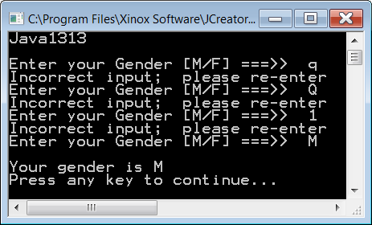
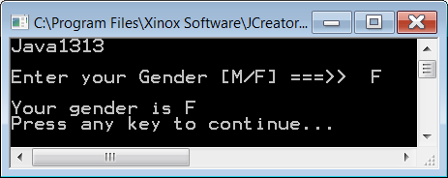


// Java1313.java
// This program accepts upper-case as well as lower-case.
// Gender input for [M/F] by using multiple conditional statements.
public class Java1313
{
public static void main (String args[])
{
System.out.println("Java1313\n");
Scanner input = new Scanner(System.in);
char gender;
boolean correct;
do
{
System.out.print("Enter your Gender [M/F] ===>> ");
gender = input.nextLine().charAt(0);
correct = (gender == 'M' || gender == 'F' ||
gender == 'm' || gender == 'f');
if (!correct)
System.out.println("Incorrect input; please re-enter");
}
while (!correct);
System.out.println();
System.out.println("Your gender is " + gender);
}
}

Slide 53
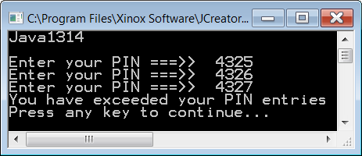
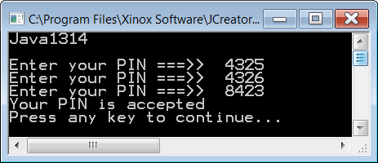
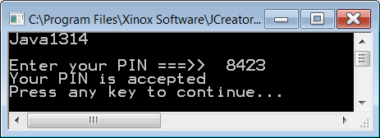
// Java1314.java
// This program shows the need for a practical compound condition
// used with an input protection loop.
// The program requests the user PIN, but rejects access after three tries.
public class Java1314
{
public static void main (String args[])
{
System.out.println("Java1314\n");
Scanner input = new Scanner(System.in);
int pin;
int tries = 0;
do
{
System.out.print("Enter your PIN ===>> ");
pin = input.nextInt();
tries++;
}
while (pin != 8423 && tries < 3);
if (pin == 8423)
System.out.println("Your PIN is accepted");
else
System.out.println("You have exceeded your PIN entries");
}
}

Slide 54
do…while & Input Protection
You will see <do..while> used frequently for input protection loops.
The post-condition loop makes sense for checking erroneous input because you want the program to enter the loop body at least one time.

Slide 55

Section 13.10
Short
Circuiting

Slide 56
Short-Circuiting with and
A and ( (A or B) and (B or C) and (A or C) or ((B and C) or (A and B)))
This statement is false whenever the first A is false.
In such a situation it is not necessary to check the remainder of the statement.

Slide 57
Short-Circuiting with or
A or ( (A or B) and (B or C) and (A or C) or ((B and C) or (A and B)))
This statement is true whenever the first A is true.
In such a situation it is not necessary to check the remainder of the statement.

Slide 58
The isEven Method
Method isEven will be used in the next 2 programs.
Not only will this method tell you if an integer is even,
it will also display output so you know if the method was called.
public static boolean isEven(int number)
{
System.out.println();
System.out.println("Calling isEven Method");
System.out.println();
if (number % 2 == 0)
return true;
else
return false;
}

Slide 59
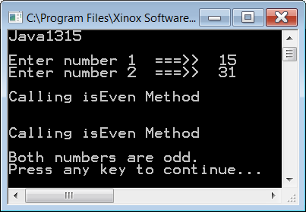
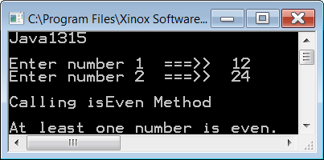

// Java1315.java
// This program uses "short circuiting" and uses the isEven
// method to demonstrate short circuiting with logical or.
public class Java1315
{
public static void main (String args[])
{
System.out.println("Java1315\n");
Scanner input = new Scanner(System.in);
System.out.print("Enter number 1 ===>> ");
int n1 = input.nextInt();
System.out.print("Enter number 2 ===>> ");
int n2 = input.nextInt();
if (isEven(n1) || isEven(n2))
System.out.println("At least one number is even.");
else
System.out.println("Both numbers are odd.");
}
public static boolean isEven(int number)
// shown already
}

Slide 60
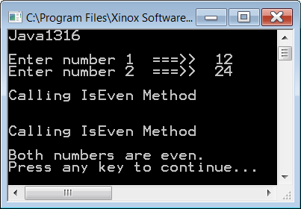
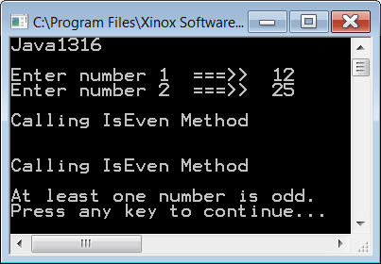

// Java1316.java
// This program uses "short circuiting" and uses the isEven
// method to demonstrate short circuiting with logical and.
public class Java1316
{
public static void main (String args[])
{
System.out.println("Java1316\n");
Scanner input = new Scanner(System.in);
System.out.print("Enter number 1 ===>> ");
int n1 = input.nextInt();
System.out.print("Enter number 2 ===>> ");
int n2 = input.nextInt();
if (isEven(n1) && isEven(n2))
System.out.println("Both numbers are even.");
else
System.out.println("At least one number is odd.");
}
public static boolean isEven(int number)
// shown already
}

Slide 61
Section 13.11
Examining the
GWCS Critter Class

Slide 62
Lab Experiment 1317 Step 1
Create a Java1317 project. Make sure to attach the GridWorld library.

Slide 63
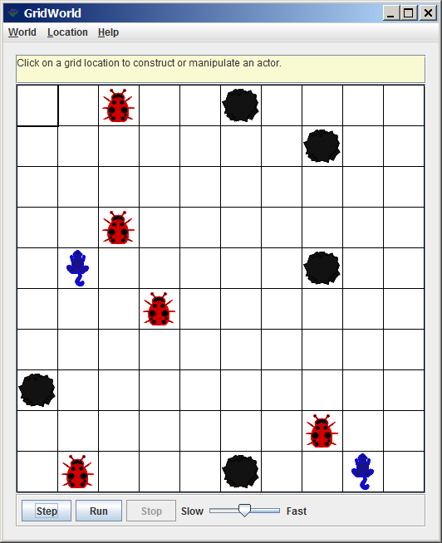
Lab Experiment 1317 Step 2
Compile and execute the project. You should see a grid with 5 bugs, 5 rocks and 2 critters. You already know the Rock and Bug objects. The new blue icons, with curly tails, are Critter objects. Click Step and observe the program execution. Multiple steps will be shown here as well, but remember that you will have a different starting screen.

Slide 64
Lab Experiment 1317 Step 3
Click the [Step] button seven times. Observe each step carefully. Compare the current step with the previous step. Watch the pictures closely and also watch your own executions. The bugs, rocks & flowers behave as you expect.

Slide 65
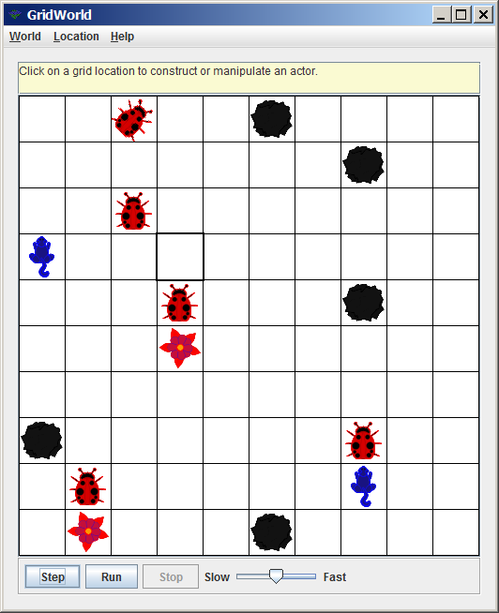
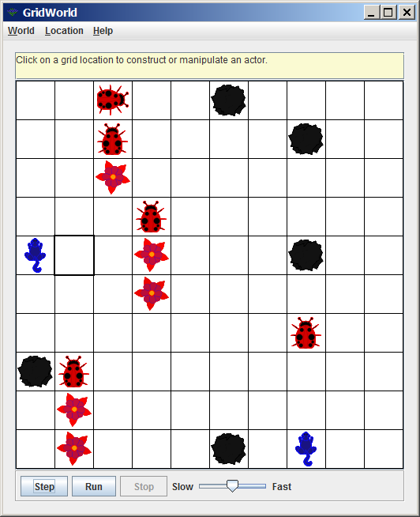
Steps 1 & 2

Slide 66
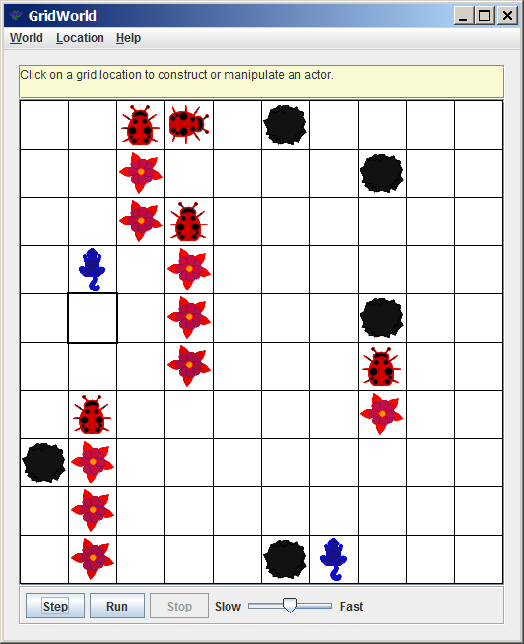
Steps 2 & 3

Slide 67
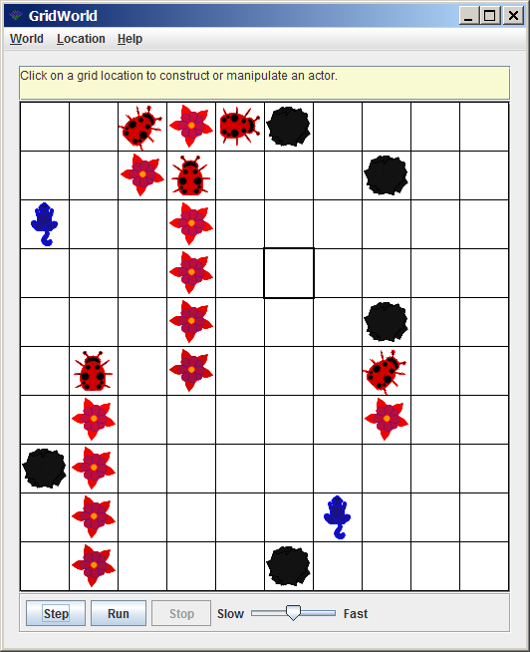
Steps 3 & 4

Slide 68
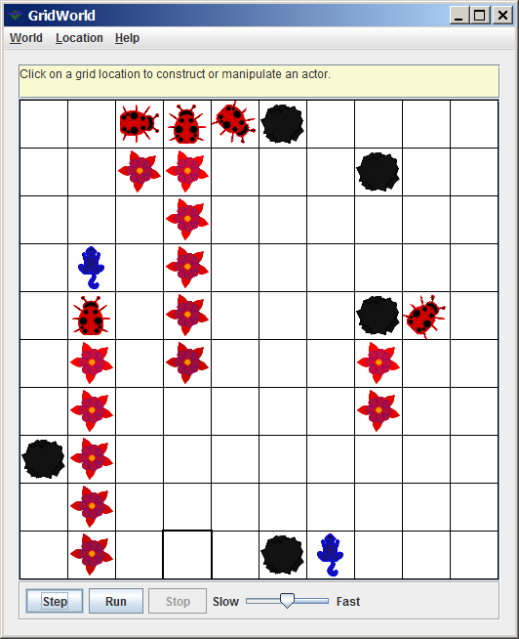
Steps 4 & 5

Slide 69
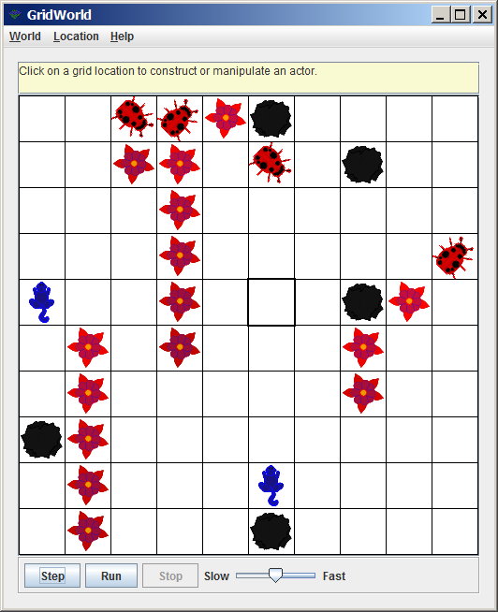
Steps 5 & 6

Slide 70
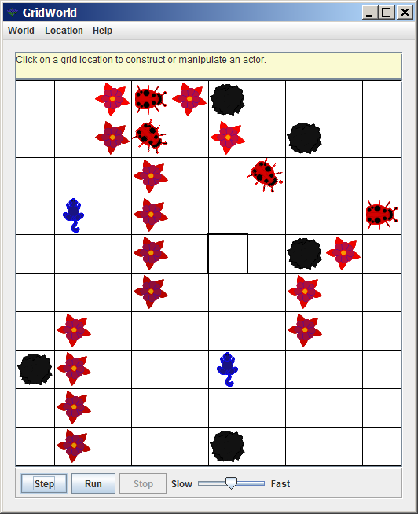
Steps 6 & 7

Slide 71
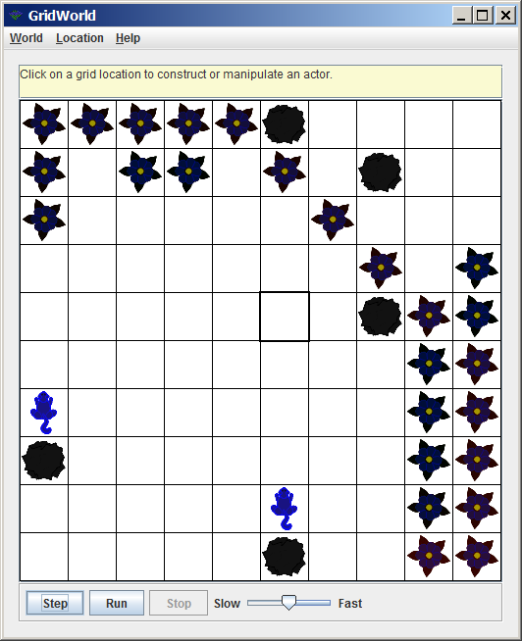
Steps 7 & 50

Slide 72
Critter Observation Questions
Ask yourself the following questions after observing the new Critters objects act from step to step: What objects disappear? Is there a pattern? Can you predict who will disappear next? How do critters move? Why do some bugs adjacent to a Critter not get removed? Are you ready to make general statements about critters?

Slide 73
Section 13.12
The Critter Class
act Method

Slide 74
Fundamental Critter Behavior Defined in the act Method
Get an array of neighbors
Process each member in this neighbor array
Move to a new location

Slide 75
public class Critter extends Actor
{
public void act()
{
if (getGrid() == null)
return;
ArrayList<Actor> actors = getActors();
processActors(actors);
ArrayList<Location> moveLocs = getMoveLocations();
Location loc = selectMoveLocation(moveLocs);
makeMove(loc);
}
public ArrayList<Actor> getActors()
{
return getGrid().getNeighbors(getLocation());
}

Slide 76
public void processActors(ArrayList<Actor> actors)
{
for (Actor a : actors)
{
if (!(a instanceof Rock) && !(a instanceof Critter))
a.removeSelfFromGrid();
}
}
public ArrayList<Location> getMoveLocations()
{
return getGrid().getEmptyAdjacentLocations(getLocation());
}

Slide 77
public Location selectMoveLocation(ArrayList<Location> locs)
{
int n = locs.size();
if (n == 0)
return getLocation();
int r = (int) (Math.random() * n);
return locs.get(r);
}
public void makeMove(Location loc)
{
if (loc == null)
removeSelfFromGrid();
else
moveTo(loc);
}
}

Slide 78
AP Exam Alert
The GridWorld Case Study counts 3/16 of the APCS Exam!

Slide 79
The instanceof Operator
instaceof is NOT a method.
instaceof is actually a relational operator that can be used to compare objects and classes.
The statement: if (barry instanceof Bug)
checks if barry is a Bug object.
In technical terms, we are checking if the object barry is an instance of the Bug class.

Slide 80
instanceof Examples
Object Creation & Condition | Condition Evaluates to
Bug barry = new Bug(); if (barry instanceof Bug) | true
Rock rocky = new Rock(); if (rocky instanceof Bug) | false
Actor bill = new Actor(); if (bill instanceof Actor) | true
Bug barry = new Bug(); if (barry instanceof Actor) | true
The reason barry is an instance of an Actor is that barry is an instance of a Bug and a Bug is-an Actor. Remember inheritance.

Slide 81
Critter Summary of Behavior
Create an array of neighbor actors in the 8 compass directions around the critter.
Process the array of actors by removing all the actors from the grid who are not a rock or a critter.
Move to a new location.
Create an array of 8 compass direction empty cell locations.
Pick one of empty locations at random.
Move to the random location.

